Slide 1
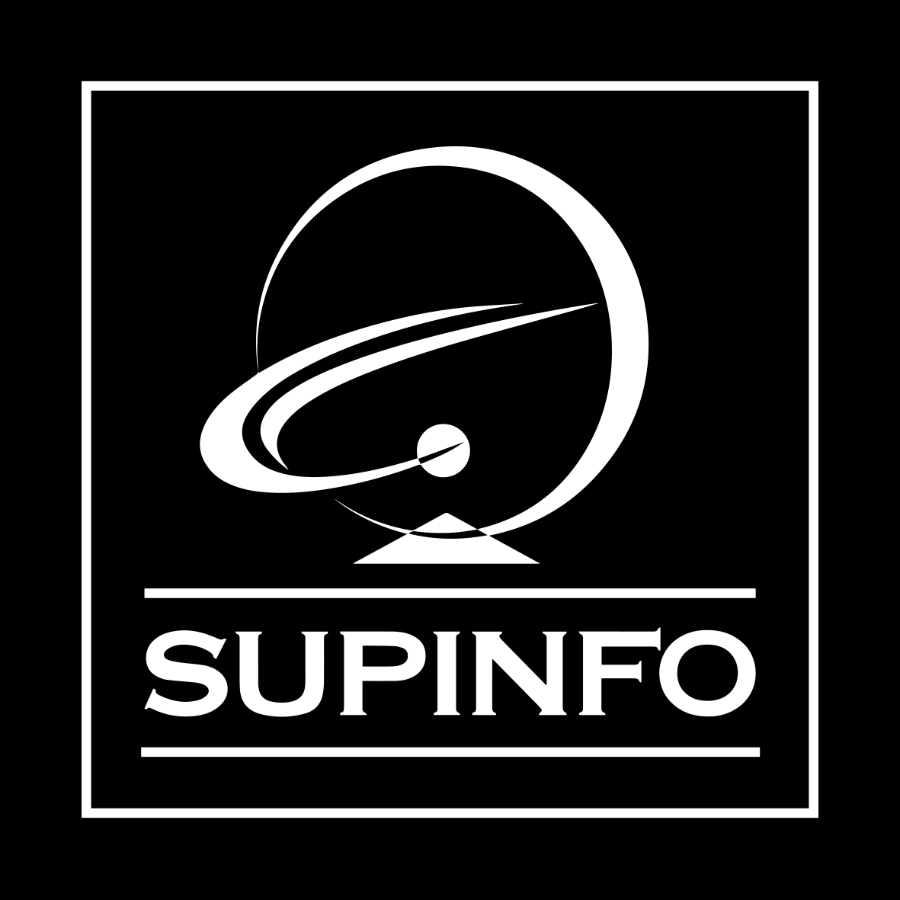
C Developer
Pointers

Slide 2

Course Objectives
Define the notion of pointer
Understand the relationship between a pointer and an array
Study the case of pointers to a structure

Slide 3
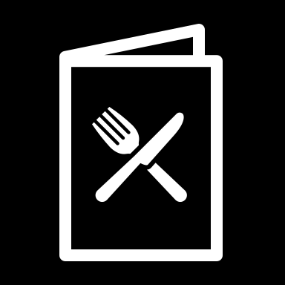
Course Plan
1. Concept of Pointers
2. Pointers and Arrays
3. Pointers and Structures

Slide 4
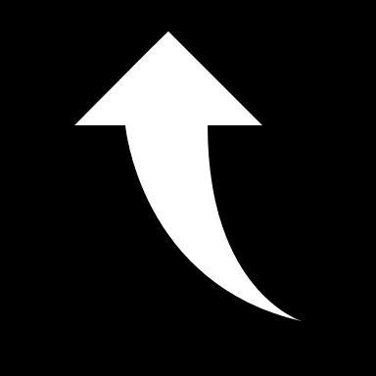
1. Concept of Pointers

Slide 5

1. Concept of Pointers
Memory organization
In a computer, the memory is organized in cells, which can be identified by their addresses
Each cell contains one byte
Address | Value
…
66280
66281
66282
66283
66284
66285
…

Slide 6
1. Concept of Pointers
Memory organization
Depending on the type of data stored, one or more cells are occupied
For example, to store a variable of char type it will take one byte:
Address | Value
…
66280
66281 | A
66282
66283
66284
66285
…
Notes:
Or 65, but just keep it simple!

Slide 7
1. Concept of Pointers
Memory organization
To store a variable of int type it will take several bytes, which can vary according to the processor or the operating system:
Address | Value
…
66280
66281 | 233
66282
66283
66284
66285
…

Slide 8
1. Concept of Pointers
Variables and memory
To declare a variable of a certain type is the same as reserving enough memory space to store a data of the given type
When the variable is used, a link is made between its name and the address where its content is stored
This is called direct access to the data

Slide 9
1. Concept of Pointers
Variables and memory
A date variable of the int type:
Address | Value
…
66280
66281 | 23101991
66282
66283
66284
66285
…
date

Slide 10
1. Concept of Pointers
Variables and memory
Given a variable, we can also access the address from which its content is stored
The address operator “&” is used for that
Its use is very simple: this operator is followed by the variable name
We already used it with scanf

Slide 11
1. Concept of Pointers
Variables and memory
A date variable of the int type:
Address | Value
…
66280
66281 | 23101991
66282
66283
66284
66285
…
&date
date

Slide 12
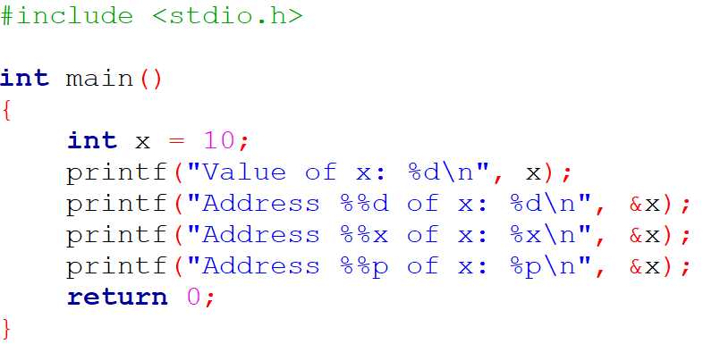
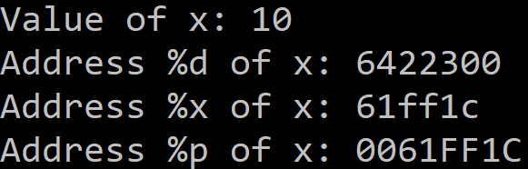
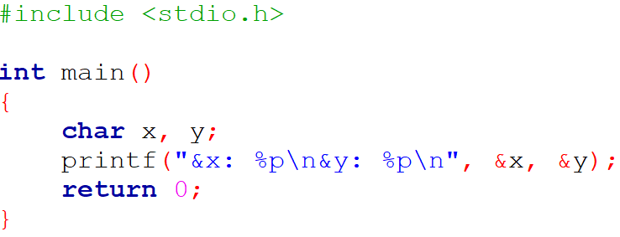

1. Concept of Pointers
Variables and memory

Slide 13

1. Concept of Pointers
Definition and use of a pointer
A pointer is a variable that contains a memory address
When declaring it, we must specify the data type that will be stored from this address
Syntax:

Slide 14
1. Concept of Pointers
Definition and use of a pointer
If we want to access the address, we use the pointer under its name, as for a classical variable
If we want to access the value, we use the indirection operator “*”
*pt is therefore the value stored from the pt address

Slide 15

1. Concept of Pointers
Definition and use of a pointer
Same example with another point of view:
Address | Value
…
66280
66281 | 23101991
66282
66283
66284
66285
…
pt
*pt

Slide 16
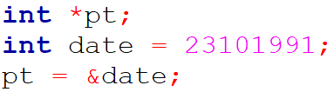
1. Concept of Pointers
Definition and use of a pointer
Same example with another point of view:
Address | Value
…
66280
66281 | 23101991
66282
66283
66284
66285
…
pt
*pt
&date
date

Slide 17
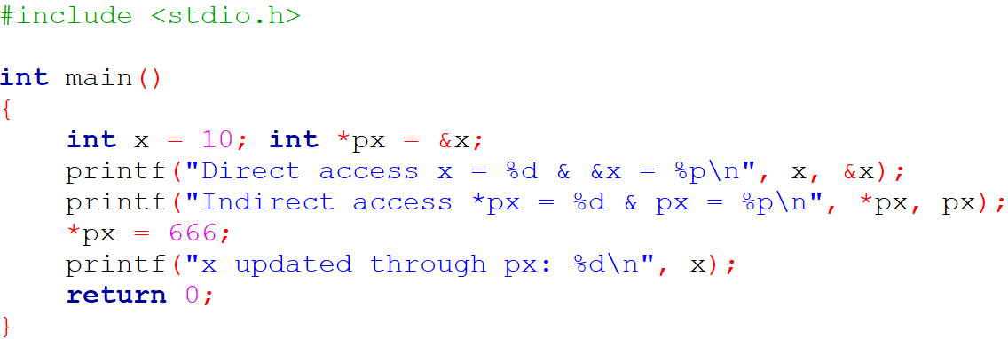
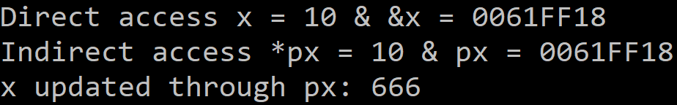
1. Concept of Pointers
Definition and use of a pointer
When manipulating a variable through a pointer containing its address, we say that we have an indirect access to the data stored under the name of the variable

Slide 18
1. Concept of Pointers
Definition and use of a pointer
When declaring a pointer, we first reserve a memory location able to contain an address
A memory location is also reserved to contain a data of the expected type if you use:

Slide 19

1. Concept of Pointers
Definition and use of a pointer
Therefore, a pointer is usually declared as follows:
In this case no memory is yet reserved to store the data and it will be only at the use of the pointer that this allocation will be done
This allows you to use memory only when you really need it
At the end of the use of the pointer, we will even free the allocated memory by reassigning the NULL value to the pointer

Slide 20
1. Concept of Pointers
Usefulness of pointers
Dynamically manage the size of arrays
Be able to modify the value of parameters passed to a function
Create dynamic variables
Be able to define data structures that are more flexible than arrays

Slide 21
1. Concept of Pointers
Dynamic variable allocation
The goal is to allocate memory for variables when you really need it
This can be useful to avoid wasting space
We can also declare variables whose lifetime will be longer than that of the subroutines using them

Slide 22


1. Concept of Pointers
Dynamic variable allocation
We declare a pointer:
When we need it, we reserve some memory for our variable:
When the use is over, we release the memory:
#include <stdlib.h>

Slide 23
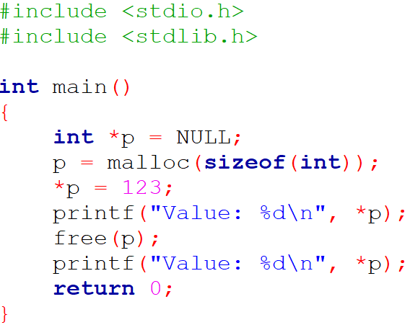

1. Concept of Pointers
Dynamic variable allocation

Slide 24
1. Concept of Pointers
Dynamic variable allocation
To allocate a block of memory, use the malloc function
Function signature:
– It takes as parameter the size of the memory block, in bytes
– The returned value is a pointer to the memory block allocated by the function; the type of this pointer is always void*, which can be cast to the desired type of data pointer in order to be dereferenceable

Slide 25
1. Concept of Pointers
Dynamic variable allocation
It can be useful to check if the dynamic memory allocation worked well, to check if there was enough space left
Otherwise, the malloc function returns the NULL value to the pointer
A simple test of nullity of the pointer will thus allow to know if we can really manipulate it
You do not want to risk overwriting other data!

Slide 26

1. Concept of Pointers
Questions

Slide 27
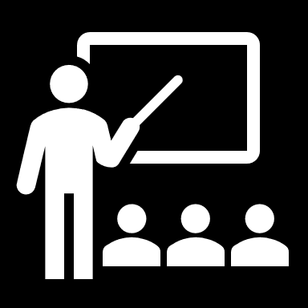
2. Pointers and Arrays

Slide 28
2. Pointers and Arrays
Pointer arithmetic
If we have an array tab and a pointer pt to the first element of this array, pt + 1 will be a pointer to the second cell of the array
The address contained in pt + 1 is thus not the address contained in pt increased by 1
There is an adjustment according to the type of the array elements

Slide 29
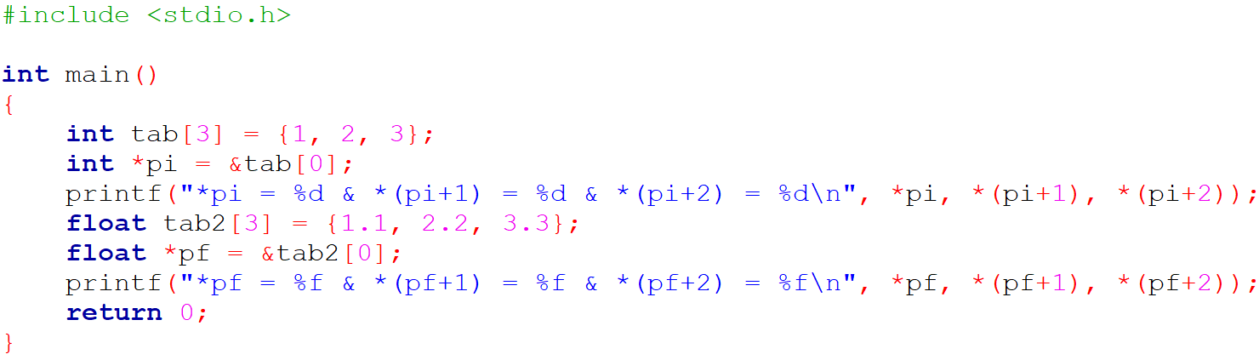
2. Pointers and Arrays
Pointer arithmetic

Slide 30
2. Pointers and Arrays
Pointer arithmetic
On the same principle, you can use the “++” increment operator with pointers
If pt is pointing to the first element of an array, after the operation pt++, it will be pointing to the second
The difference between pre and post increment is still the same

Slide 31
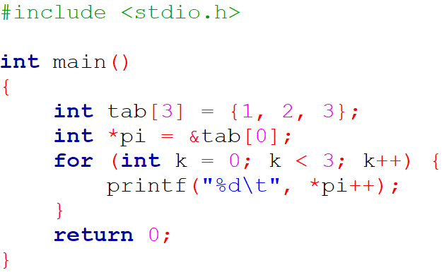
2. Pointers and Arrays
Pointer arithmetic

Slide 32
2. Pointers and Arrays
Pointer arithmetic
The subtraction and decrement operations take place in the same way as the addition and incrementation operations, but in order for them to make sense the corresponding pointer must not refer to the first cell of the array
You will not cause a compile error, but you will access other data; with the risk of uncontrolled modifications that this involves

Slide 33
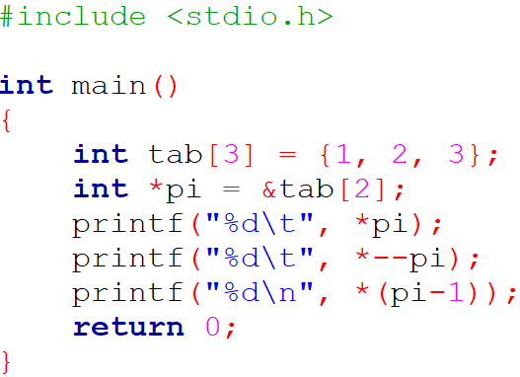

2. Pointers and Arrays
Pointer arithmetic

Slide 34

2. Pointers and Arrays
Pointer arithmetic
If you have declared an array:
The name of the array, here tab, is always the address of its first cell
Thus, tab and &tab[0] are equivalent
tab is therefore a pointer, but a constant pointer that will always point to the first element of the array (it cannot be assigned another value)

Slide 35

2. Pointers and Arrays
Pointer arithmetic
Since tab is a constant pointer, operations like tab++ are forbidden
On the other hand, if pt is a pointer of the same type, we can make assignments of the following form:
&tab[n] and tab+n are two identical addresses
tab[n] and *(tab+n) are two identical values

Slide 36
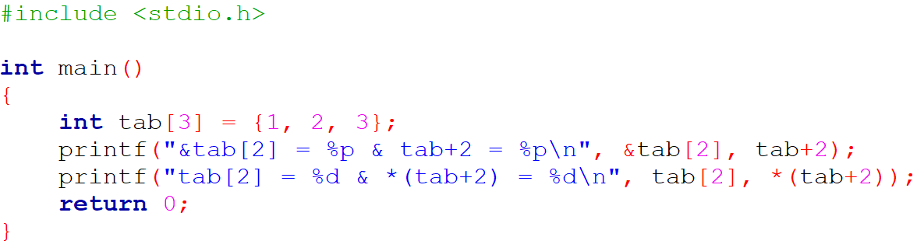

2. Pointers and Arrays
Pointer arithmetic

Slide 37

2. Pointers and Arrays
Pointer arithmetic
If you have declared an array:
Then a pointer:
Then the writing pt[n] makes sense and is worth *(pt+n) (and thus also tab[n])

Slide 38
2. Pointers and Arrays
Pointer arithmetic
If you have declared an array:
Then a pointer:
Then the writing pt[-n] makes sense and is worth *(pt-n) (and thus also tab[k-n])

Slide 39
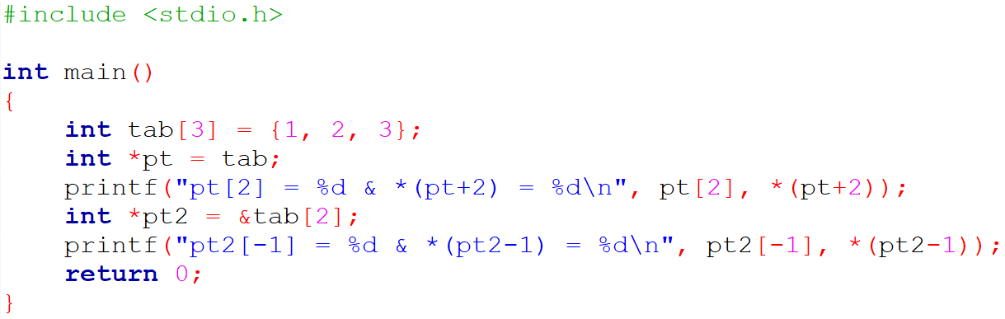

2. Pointers and Arrays
Pointer arithmetic

Slide 40

2. Pointers and Arrays
Constant strings and pointers
An assignment like the one below, means that we initialize ps with the address of the “Hello world!” constant string:
You cannot change the value of a constant; this operation is therefore illicit:

Slide 41
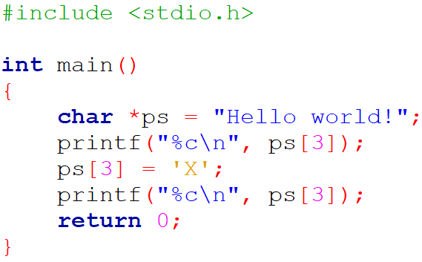
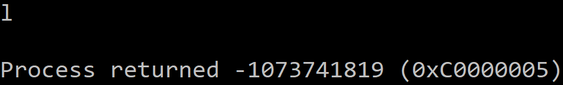
2. Pointers and Arrays
Constant strings and pointers

Slide 42
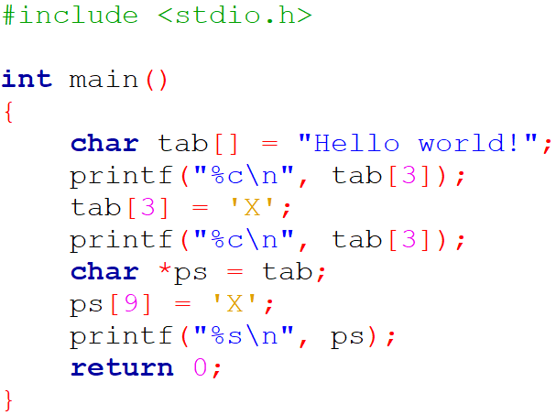
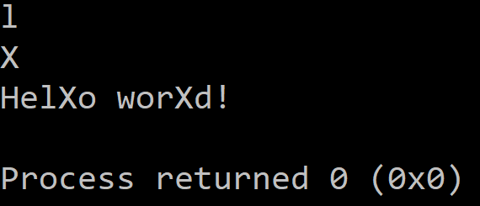
2. Pointers and Arrays
Constant strings and pointers

Slide 43
2. Pointers and Arrays
Dynamic array allocation
The goal here is to be able to define arrays whose dimension is known only at the program execution
For example, if this dimension is entered by the user himself, or if it is the result of a calculation
We need to use the malloc function

Slide 44
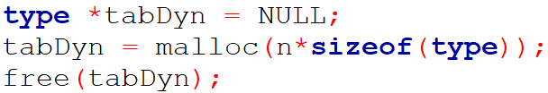
1. Concept of Pointers
Dynamic array allocation
Same procedure as for a variable, but with n elements:
The sizeof function allows you to know the number of bytes that a variable of a given type takes in memory; using it ensures the portability of the program, because from one computer to another the same type can be stored with different numbers of bytes
As in the case of a dynamic variable, precautions can be taken by checking that the allocation is successful
#include <stdlib.h>

Slide 45
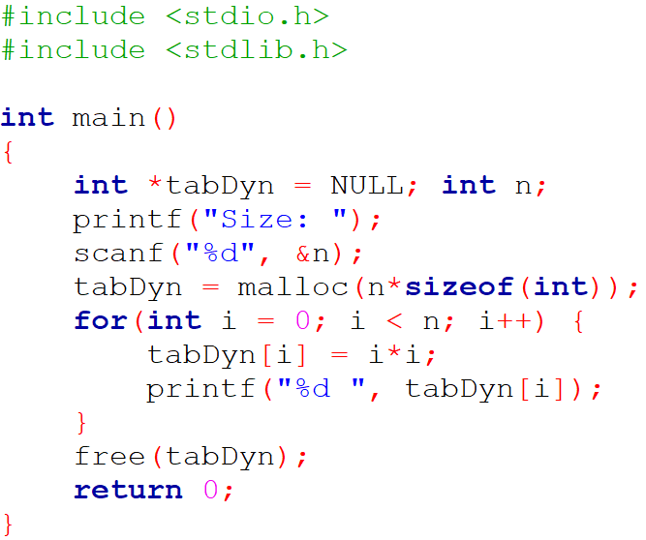

1. Concept of Pointers
Dynamic array allocation

Slide 46
2. Pointers and Arrays
Static arrays of pointers
We declare a usual static array (not dynamic):
type *tab[dim];
For each row i we size the number n of columns:
tab[i] = malloc(n_{i}*sizeof(type));
When the use is over, we release the memory on each row:
free(tab[i]);

Slide 47
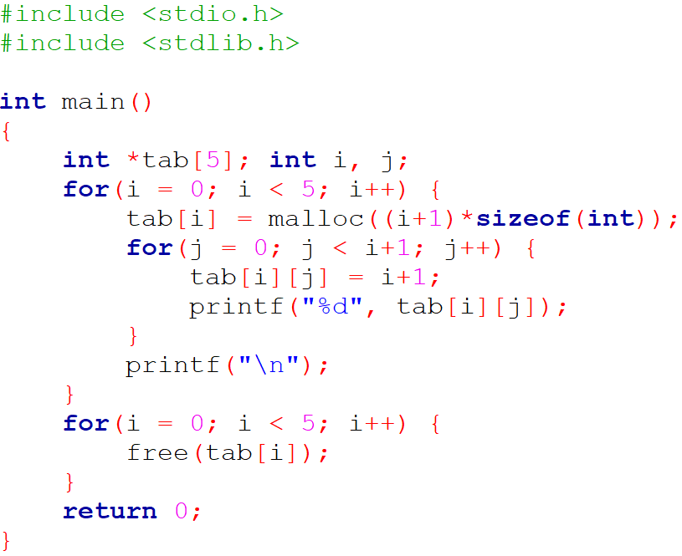
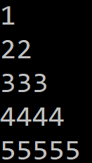
2. Pointers and Arrays
Static arrays of pointers

Slide 48
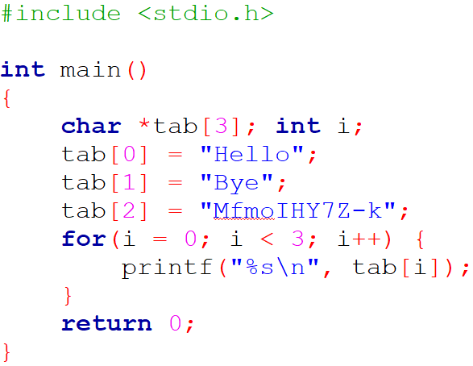
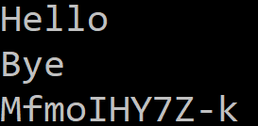
2. Pointers and Arrays
Static arrays of pointers

Slide 49
2. Pointers and Arrays
Dynamic arrays of pointers
We declare a double pointer:
type **tab;
We then size the number m of rows:
tab = malloc(m*sizeof(type*));
For each row i we size the number n of columns:
tab[i] = malloc(n_{i}*sizeof(type));

Slide 50

2. Pointers and Arrays
Dynamic arrays of pointers
When the use is over, we release the memory on each row:
free(tab[i]);
We then free the memory allocated to the array:
free(tab);

Slide 51
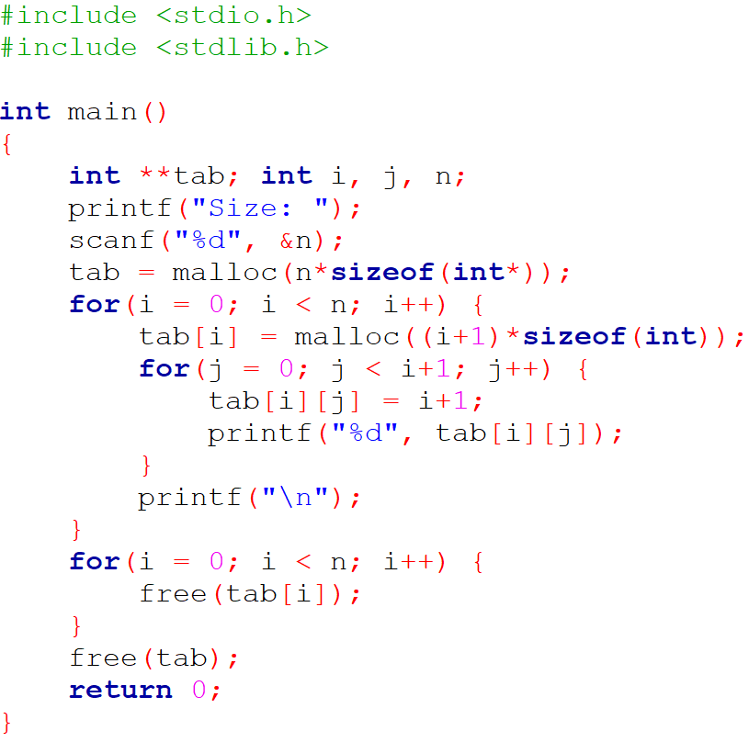
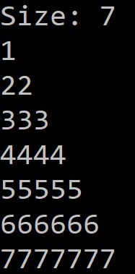
2. Pointers and Arrays
Dynamic arrays of pointers

Slide 52
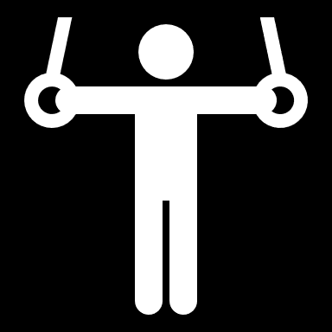
2. Pointers and Arrays
Exercise
Make the user enter the size of an array of integers
Fill it in randomly using the rand function
Calculate the maximum of the array
Notes:
The C library function int rand(void) returns a pseudo-random number in the range of 0 to RAND_MAX.
RAND_MAX is a constant whose default value may vary between implementations, but it is granted to be at least 32767.

Slide 53
2. Pointers and Arrays
Questions

Slide 54

3. Pointers and Structures

Slide 55
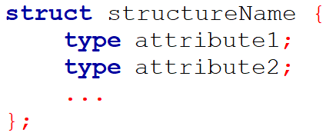
3. Pointers and Structures
Pointers to a structure
We can define pointers to a structure:
We can declare pointers to complex data types that we define ourselves

Slide 56


3. Pointers and Structures
Pointers to a structure
There are two ways to access the attributes:
– In the usual way:
– With the arrow operator “->”:
We will prefer the second syntax which is less cumbersome

Slide 57
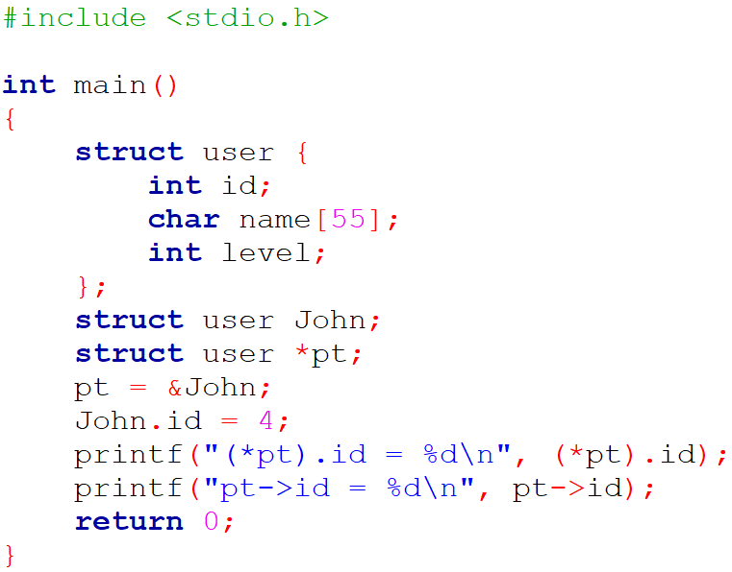

3. Pointers and Structures
Pointers to a structure

Slide 58
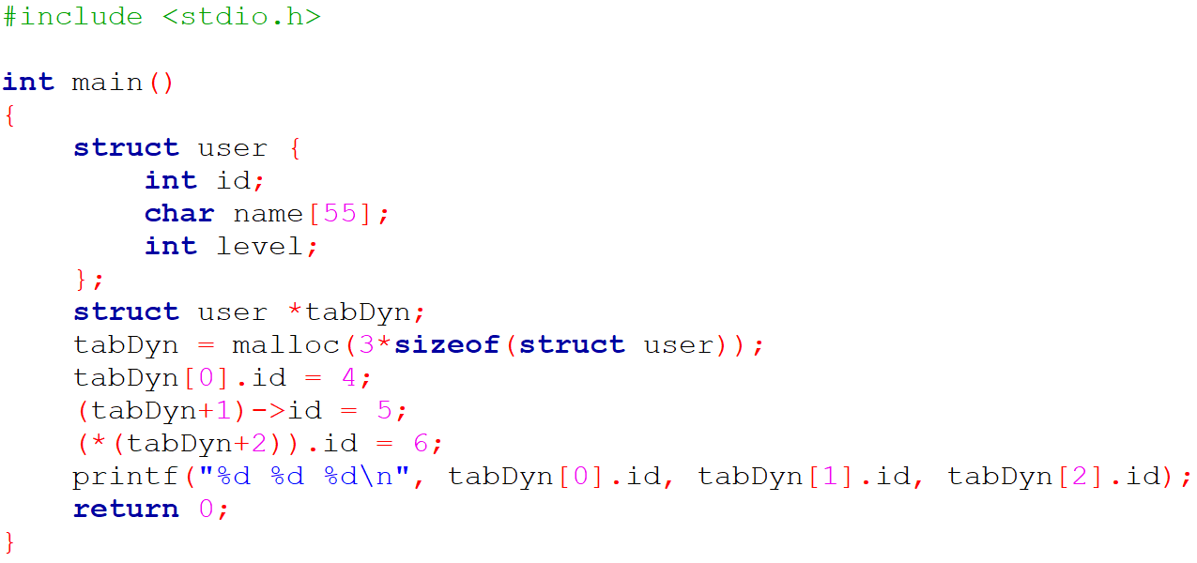

3. Pointers and Structures
Dynamic arrays of structures
Dynamic arrays of structures can be defined as with an elementary type
The sizeof function also works with complex data types that we define

Slide 59
3. Pointers and Structures
Questions

Slide 60

C Developer
Pointers
Thank you for your attention

